Slide 1
ApexBot
Optimizing UX by Accelerating Query Resolutions
October 11th, 2024
To select an alternate cover image do the following:
Right click the link below and select: Hyperlink > Open Hyperlink Choose Image
Download the image you want
Add picture from your desktop
Notes:
Thanks Vedant and Shivani for setting the benchmark
Greetings everyone.
I am Raghav Gupta, pursuing my masters in business analytics at Cal State. Data Engineer Intern at Apexon.
Today, After almost 2 months of teamwork. Thanks to the mentorship of Samuel, Guidance of Prasanth, all the leadership meetings to understand the importance of business value better and deliver a solution aligning with that.
So, we are excited to present our AI-powered solution: ApexBot a Chatbot Assistant for Apexon.com.
The solution revolutionizes how we handle customer interactions and inquiries, leveraging cutting-edge technology to provide instant, Apexon-specific responses and optimize the user experience at the apexon website.

Slide 2
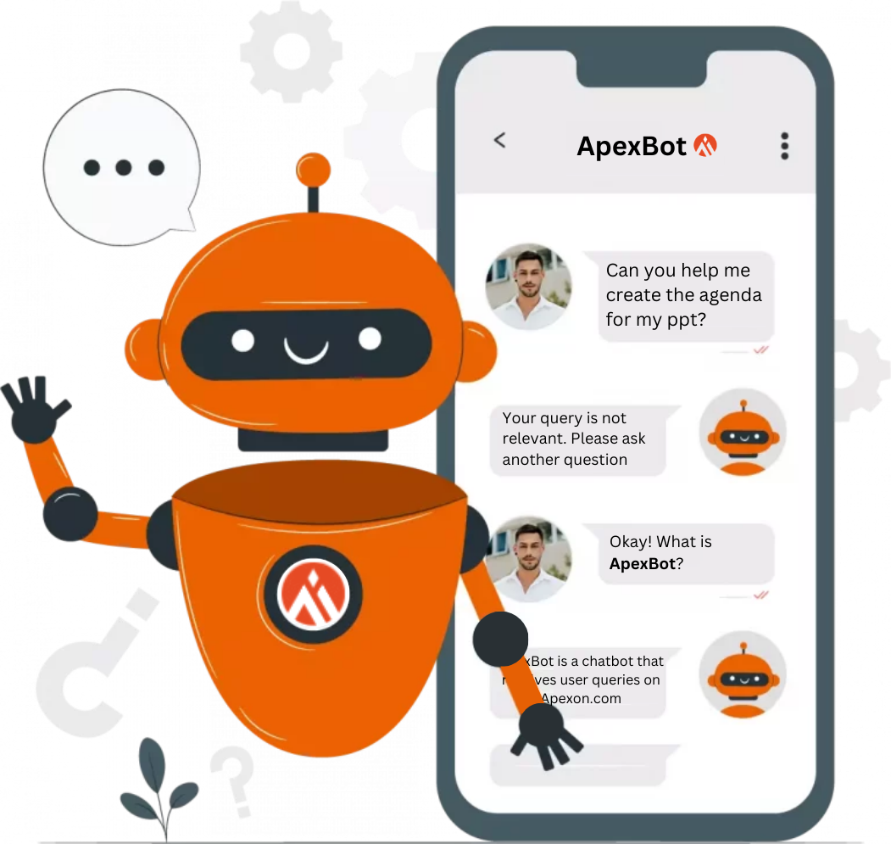
AGENDA
EXECUTIVE SUMMARY
MARKET ANALYSIS
SOLUTION DEEP-DIVE
LEARNINGS & CHALLENGES
NEXT STEPS
Notes:
1. Today to have a better understanding of our solution we'll go through the
2. Logo for the Apexbot and as you can see on the right side of the screen, Apexbot won't entertain the general queries of the user and will tend to focus just on queries related to Apexon

Slide 3
EXECUTIVE SUMMARY
We enable #HumanFirstDIGITAL
To select an alternate cover image do the following:
Right click the link below and select: Hyperlink > Open Hyperlink Choose Image
Download the image you want
Add picture from your desktop

Slide 4

EXECUTIVE SUMMARY
SOLUTION OVERVIEW
The Conversational AI Chatbot, ApexBot, harnesses AI to transform customer support, leveraging OpenAI's GPT-4-Turbo model and ChromaDB
KEY FEATURES
Instant Data Retrieval: Rapid, accurate responses via vectorized embedding search.
AI-Powered Conversations: Contextual, human-like responses powered by GPT.
Enterprise Customization: Adaptable in diverse applications such as customer service and knowledge management, using microservice architecture.
POTENTIAL BUYER MARKETS
E-Commerce
Healthcare
Finance
MARKET VALUE OF AI CHATBOTS
2023: $5.39 billion
2033 (Projected): $42.83 billion, CAGR of 23.5% (based on statistics & reports)
Legal
Insurance
And more…
Notes:
Why GPT over others(llama/hugging face) - Accurate responses and scope of scalability of the solution.

Slide 5
MARKET ANALYSIS
We enable #HumanFirstDIGITAL

Slide 6
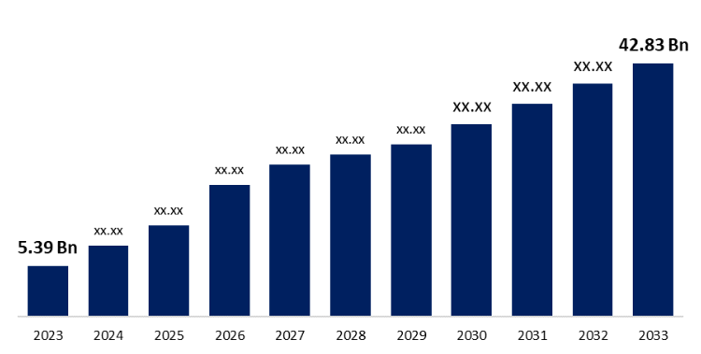
MARKET VALUE
Global Projected Value
Yahoo Finance:
2023 Market Size: $5.39 billion
Projected 2033 Market Size: $42.83 billion
Compound Annual Growth Rate (CAGR): 23.03%
The Future of Conversational AI: Key Predictions
Juniper Research: E-commerce transactions via chatbots to hit $112B by 2024.
CNBC: By 2024, chatbots will manage 75-90% of customer requests.
Gartner: By 2027, chatbots will be the main customer service channel for 25% of enterprises.
Invespcro: Advanced chatbots cut customer service costs by 50%.
Notes:
Positive curve
We came across some key predictions from reputed agencies like Juniper research, Gartner, CNBC and Invesp Cro which suggests that

Slide 7








POTENTIAL BUYER MARKETS
E-Commerce
Use Case: Customer support, product recs, order tracking
Benefit: Boost sales, reduce costs, enhance engagement.
Healthcare
Use Case: Appointment scheduling, treatment FAQs.
Benefit: Improves patient access, reduces admin workload.
Financial Services
Use Case: Account queries, loan advice, transaction history.
Benefit: Enhances user experience, offers 24/7 support.
Real Estate
Use Case: Property inquiries, price details, scheduling tours.
Benefit: Increases lead generation, streamlines searches
Legal Services
Use Case: Client queries, consultation scheduling.
Benefit: Automates lead qualification, boosts efficiency.
Insurance
Use Case: Policy info, claims processing, quotes.
Benefit: Speeds up claim handling, improves customer service.
SaaS / Tech
Use Case: Onboarding, technical support, troubleshooting.
Benefit: Reduces support tickets, improves customer success.
Non-Profit
Use Case: Donations, volunteer inquiries, event info.
Benefit: Engages donors, streamlines fundraising.
Notes:
potential market in multiple domains like ecommerce, ...
Lately I have been using amazon lately and I didn't have to call customer care in fact got my query resolved in under 5 minutes.
AI Chatbot Response Time - few seconds
Call Centers Several minutes or longer
Website Forms - 24-72 hours
Email Support - 24-48 hours

Slide 8
SOLUTION DEEP-DIVE
We enable #HumanFirstDIGITAL
To select an alternate cover image do the following:
Right click the link below and select: Hyperlink > Open Hyperlink Choose Image
Download the image you want
Add picture from your desktop

Slide 9







TECH STACK
OpenAI
Drives conversational AI with advanced language models for nuanced query responses.
CSV
Facilitates initial data storage and quick data access during development phases.
Python
Primary language for backend development, data processing, and script integration.
Streamlit
Builds interactive, dynamic user interfaces for enhanced end-user interaction.
Chroma
Manages and retrieves vectorized data embeddings for efficient, relevant data querying.
LangChain
Enables the integration of large language models with external data sources for enhanced reasoning and retrieval capabilities.
Selenium
Enables dynamic web scraping, interacting directly with web elements for real-time data extraction
This Photo by Unknown Author is licensed under CC BY-SA

Slide 10







SOLUTION ARCHITECTURE
Knowledge Base
URL
Cleaned Data
Website Data
Links, Cookies notice, forms, blogs, articles, etc
Python
Data Extraction & Preprocessing
Store Data
Query
Query
Streamlit
(FrontEnd)
Embedded Query Vector
User
Response
OpenAI Embeddings
cleaned_website_data.csv
Response
Search Layer
Top 3 paragraphs
Embedded Paragraphs
Data Chunks (Paragraphs)
Chroma
OpenAI Completion
Stores embedded paragraphs and compares to embedded query
OpenAI Embeddings
LangChain
Recursive Chunking

Slide 11



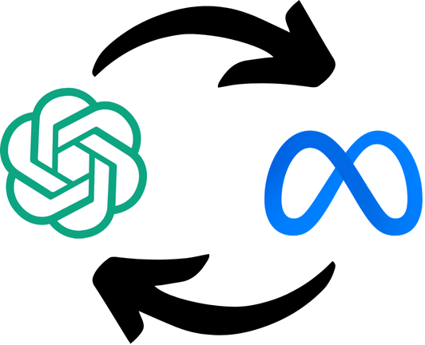
BEST PRACTICES
Continuous Integration and Deployment
Practice: Implement CICD pipelines to automate testing and deployment processes.
Benefit: Ensures consistent code quality, reduces manual errors, and speeds up the delivery of new features and fixes.
Modular Code Design
Practice: Develop code in modular blocks to facilitate easier updates, debugging, and scalability.
Benefit: Simplifies maintenance and allows for rapid adaptation to new requirements or changes in technology.
Robust Error Handling and Logging
Practice: Incorporate comprehensive error handling and detailed logging throughout the application.
Benefit: Aids in quick diagnosis and resolution of issues, improving reliability and user trust.
Flexible Technology Stack
Practice: Choose a technology stack enabling easy sub or integration of different AI models and services.
Benefit: Facilitates quick adaptation to the best available technologies and services, such as switching from OpenAI to LLaMA-2 or Gemini as needed.

Slide 12



LEARNINGS & CHALLENGES
We enable #HumanFirstDIGITAL

Slide 13

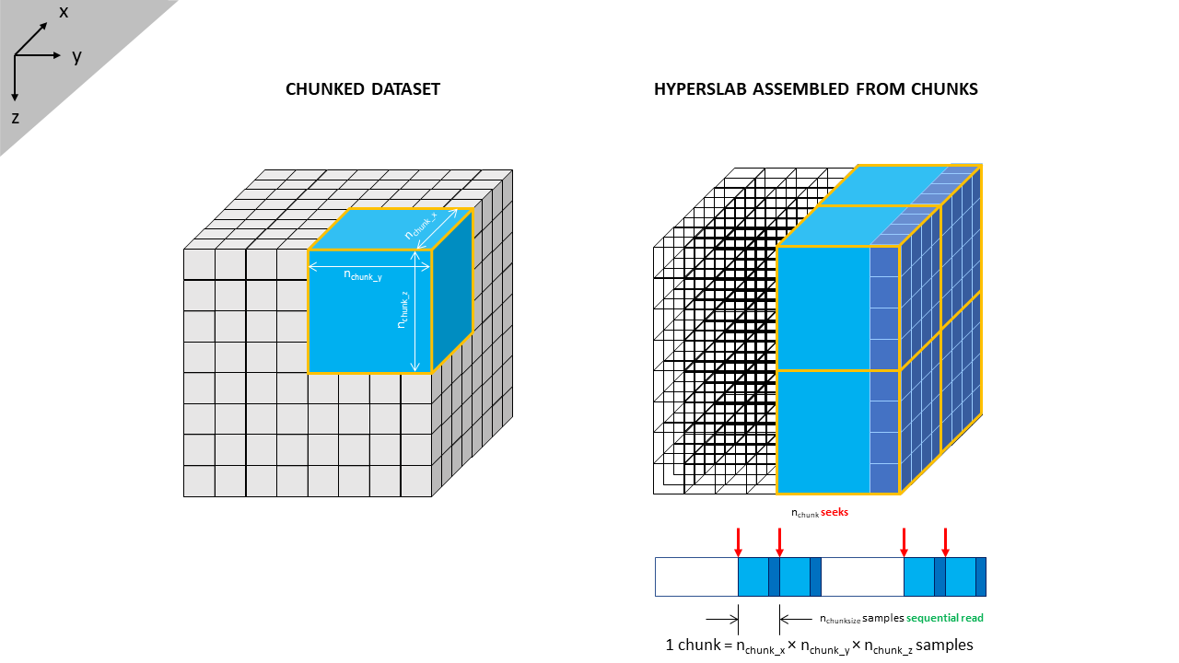


CHALLENGES AND SOLUTIONS
Data Extraction Variability
Chunking Techniques
Optimal Vector Database
Implementing Guardrails
Challenge: Variations in retrieval speed and accuracy across databases.
Solution: Transitioned from FAISS to ChromaDB for improved balance in speed and accuracy.
Challenge: Chatbot handling irrelevant queries, wasting resources.
Solution: Introduced front-end guardrails to filter non-essential questions, optimizing performance and user experience.
Challenge: Initial reliance on uniform data scraping methods led to inconsistent data quality
Solution: Implemented combination of Selenium for dynamic content and Requests for static pages, enhancing data consistency.
Challenge: Inconsistent text segmentation affecting data quality.
Solution: Switched to recursive semantic chunking for better context capture, enhancing response relevance.
13

Slide 14
PROJECT LEARNINGS
Insight: Theoretical knowledge of AI and machine learning frameworks was greatly enhanced by practical application in a dynamic environment.
Application: Hands-on experience with real-world data and user interactions refined our approach to AI-driven solutions.
Adapting to Real-World Applications
Insight: Understanding user needs and behaviors was key to designing a chatbot that genuinely improves the user experience.
Application: Continuous feedback loops with end-users helped tailor the chatbot to meet specific user demands and expectations.
Importance of User-Centric Design
Insight: Staying updated with the latest advancements in technology, such as Generative AI and microservices, propelled our project forward.
Application: Regular training and research into new tech tools enabled the team to implement the most effective solutions promptly.
Leveraging Cutting-Edge Technology
Insight: Building the solution with scalability and flexibility in mind was essential for handling increasing loads and future expansions.
Application: Designing the architecture to be modular allowed for easy updates and integration of new features without disrupting existing functionalities.
Scalability and Flexibility

Slide 15
NEXT STEPS
We enable #HumanFirstDIGITAL
To select an alternate cover image do the following:
Right click the link below and select: Hyperlink > Open Hyperlink Choose Image
Download the image you want
Add picture from your desktop

Slide 16
DEVELOPMENT ROADMAP
1
2
3
Full Website Integration
Objective: Expand application to encompass entire Apexon website.
Purpose: Provides a unified user experience across all web pages, making every piece of data accessible through the chatbot.
Advanced NLP Features
Objective: Integrate advanced NLP features to improve chatbot’s understanding and response capabilities.
Purpose: Enhances the chatbot's ability to interpret complex queries and deliver more accurate and contextually appropriate responses.
Continuous Learning Mechanism
Objective: Develop continuous learning framework for chatbot to learn from interactions and improve over time.
Purpose: Enables system to adapt to new information and changing user behaviors, continuously improving effectiveness and accuracy.

Slide 17


THANK YOU
EMAIL US
INFO@APEXON.COM
TALK TO US
+1-408-727-1100
We enable #HumanFirstDIGITAL

